Slide 1
Our Big Shiny Geek Show Database Project
by Aprillemae Hanley & Patty Bailey

Slide 2
Goals for the project
The purpose of the Big Shiny Geek Show Pub Quiz database is to keep track of pub quiz questions written and provide a compelling interface for pub quiz participants.

Slide 3
Tasks
UI for online play
User accounts and high scores
Archive for Pub Quiz winners
Weekly Pub Quiz stats
Final Standings and scores
Winners
Pictures
Homepage
Info on location/times, hosts, rules, awards, announcements, etc.
Admin accounts

Slide 4
Data Gathered From:
Questions/Answers written and used for our previous pub quizzes
Actual Teams who play at pub quiz
Actual results from our weekly quiz

Slide 5
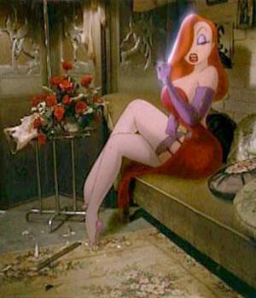
Data Model

Slide 6
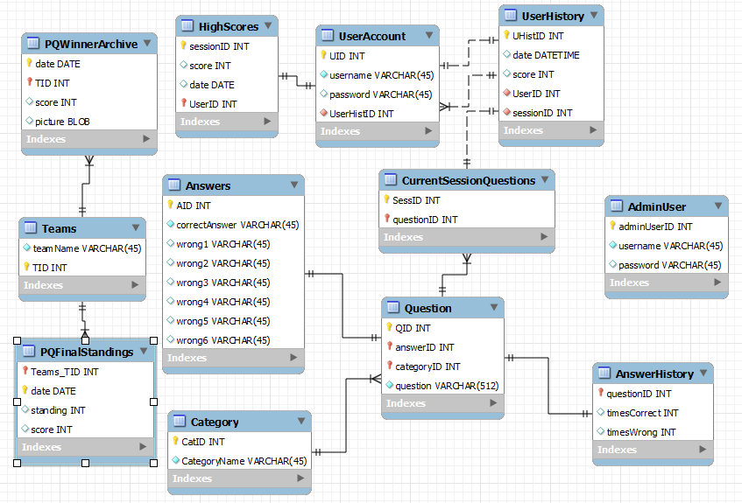

Slide 7
Implementing with mysql
Simple to implement
Simple to edit within mysql
Ran into problems when trying to work with Cerberus, Django, and mysql

Slide 8
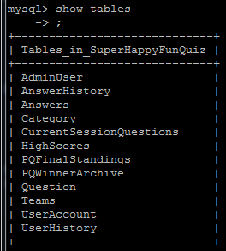
Tables in
mysql

Slide 9
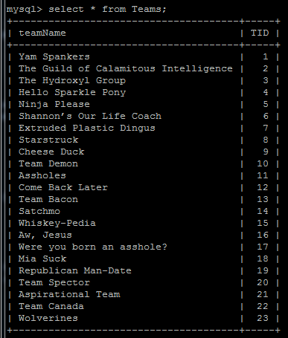
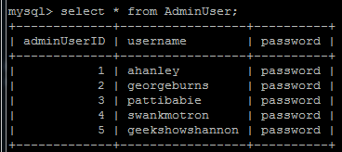
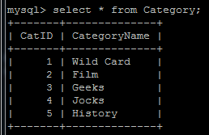
Tables

Slide 10
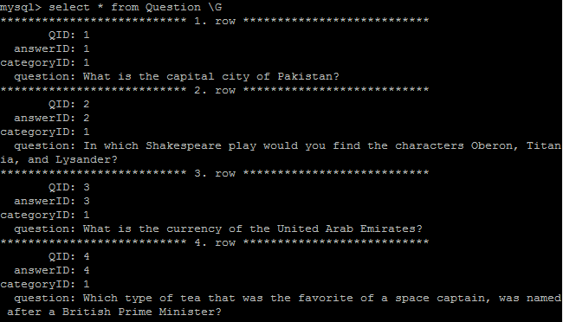
Question Table: started with 50 questions
10 in each category

Slide 11
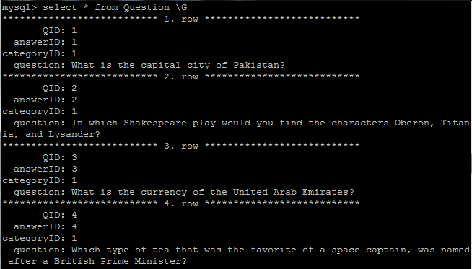
Answers Table:

Slide 12
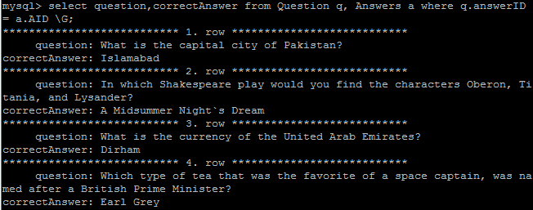
Question & Answer Query:

Slide 13
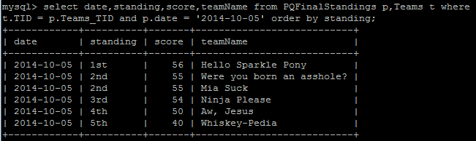
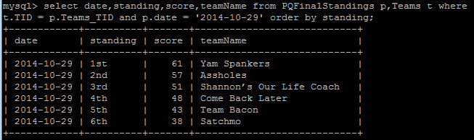
Final Standings Queries by date:

Slide 14
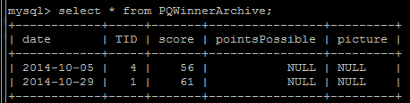
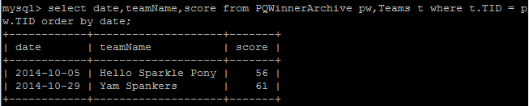
Winner Archive Table:
Winner Archive Query:

Slide 15
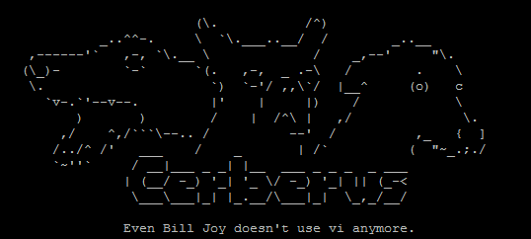
Problems we encountered:

Slide 16
Solutions:
Broke up with mysql
Started going steady with SQLite
Moved in with Django
Messed around with Python a lot
Saw Google on the side

Slide 17
New Goals and Tasks:
Functional Admin account
Ability to add new questions/answers
Ability to add new users
Basic functional quiz
UI for online play
Sleep.

Slide 18
Overly Ambitious Concept

Slide 19
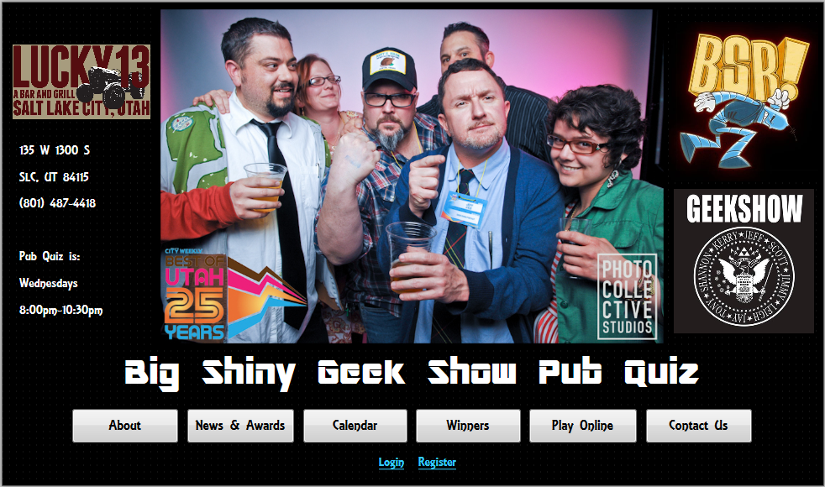

Slide 20
Meanwhile, in reality...

Slide 21
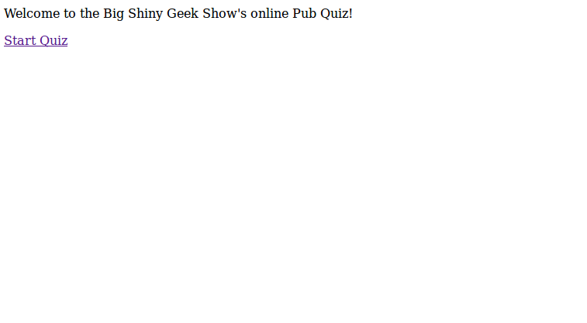

Slide 22
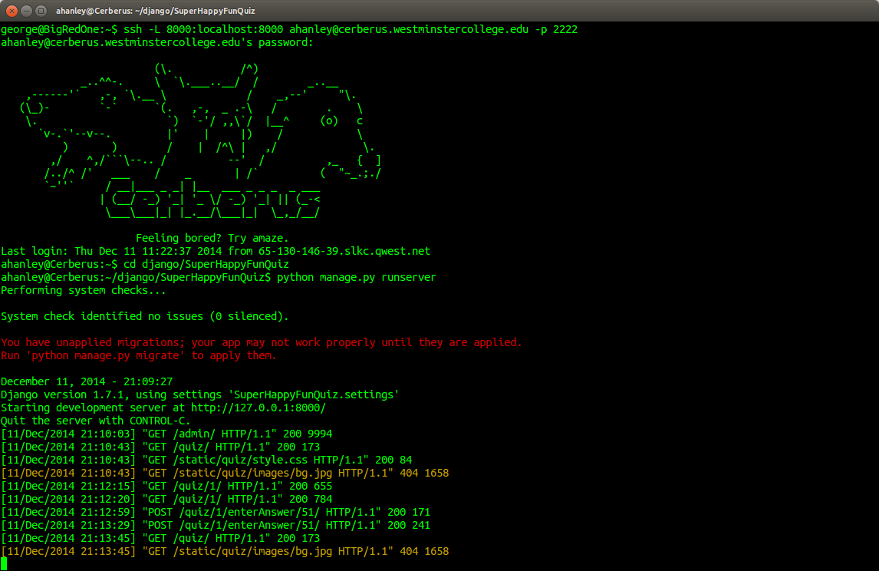

Slide 23
